Slide 1

One Stop Solution(OSS)
Team Name: SP
Team members: Priyanka Sanjay Madekar
Sakshi Chandrakant Shinde
Track: OPEN INNOVATION

Slide 2

CatLog
S.No | Label | Page no.
1 | Problem Statement | 3
2 | Our Idea | 4
3 | Blind Spots | 5
4 | Air Quality & Weather Prediction | 6
5 | Traffic Volume | 7
6 | Recommendations | 8
7 | Gallery | 9

Slide 3

Problem statement
This open innovation challenge invites participants from diverse backgrounds to unleash their creativity and propose transformative solutions that transcend traditional notions of transportation. The goal is to reimagine and redefine global mobility, addressing not only safety concerns but also the broader environmental impact. Participants are encouraged to think beyond conventional boundaries and contribute ideas that can revolutionize the way we move and connect

Slide 4

Our idea
blind spots on the road to prevent accidents – those tricky areas where drivers can't see. It also checks the air pollution, letting us know if the air is clean or if there's pollution. When it comes to the weather, it predicts what it's going to be like so you can plan your day. And for areas where they might need better water routes, it gives suggestions. It's like having a helpful buddy

Slide 5
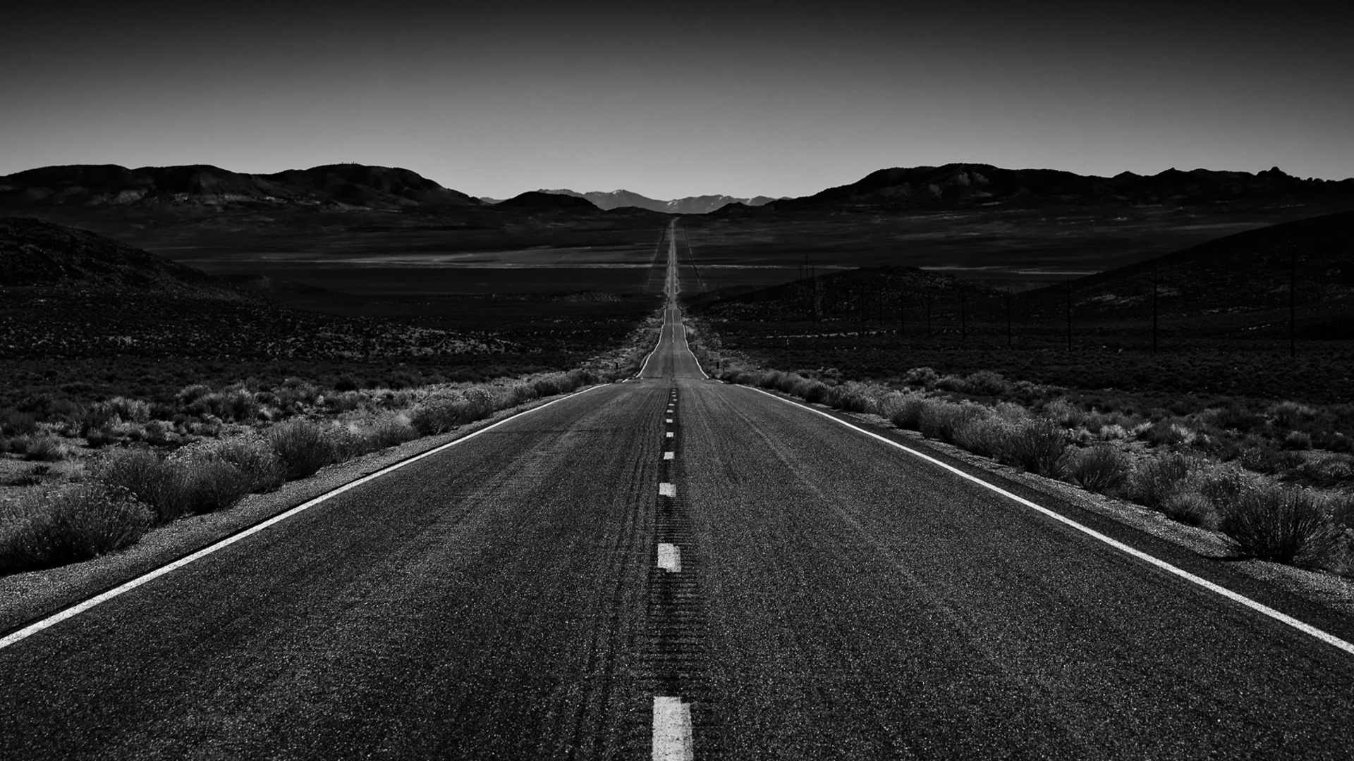
Blind spots
file
GridSearch CV
Send message
Checking who can access file
GridSearch CV
It watches out for blind spots on the road to prevent accidents – those tricky areas where drivers can't see
When travelling, for example from Mumbai to Pune it may tell where the blind spots are located
It uses random regressor model for prediction
0 is for “No blind spot” and 1 for “Blind Spot present”

Slide 6

Air quality & weather prediction
Checks the air quality, letting us know if the air is clean or if there's pollution.
When it comes to the weather, it predicts what it's going to be like so you can plan your day.
It uses random regressor model and GridSearch CV for prediction.

Slide 7

Traffic volume
Traffic Volume – What density of traffic may be on next day.
This helps to plan your journey efficiently
This uses LinearRegressor model along with TimeSeries Analysis to predict traffic density

Slide 8
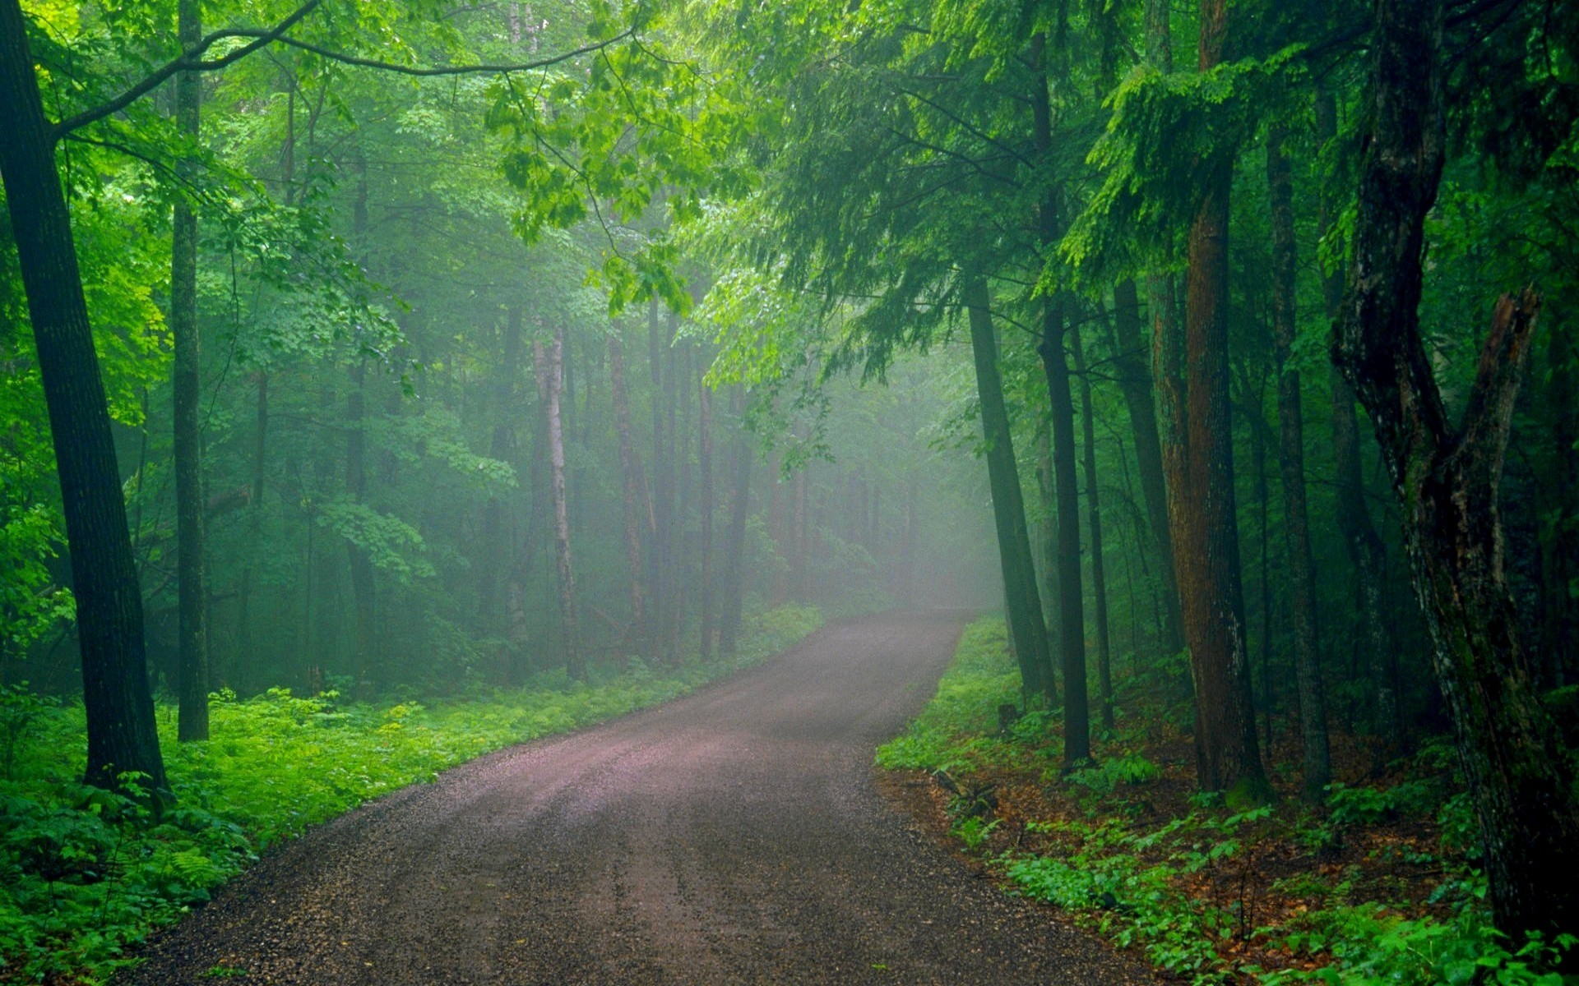
recommendations
This tab is exclusively for government use
Considers various factors and predicts if road needs to be repaired or developed or if the region has possibility for waterway.
Waterway – If a region has possibility to develop their waterway, it give suggestion
RandomRegressor is used This helps to reduce dependency on roadway for transport thereby reducing traffic and saving money

Slide 9

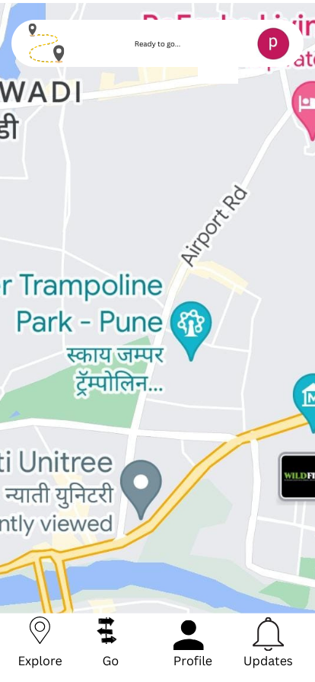
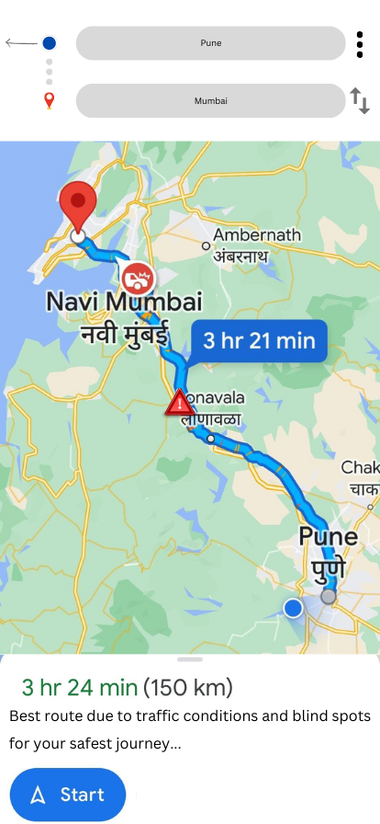
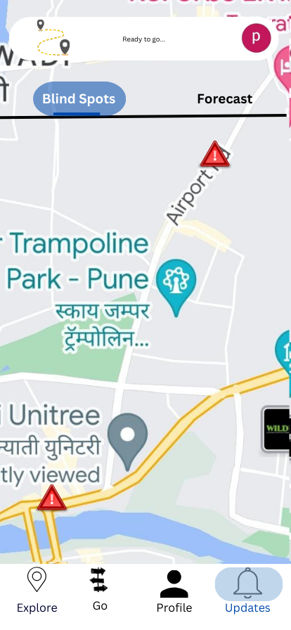
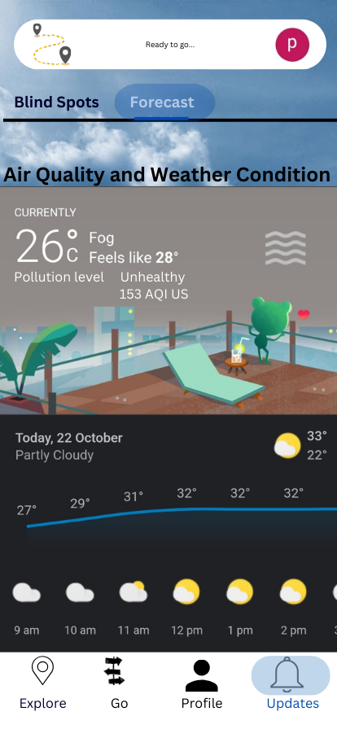
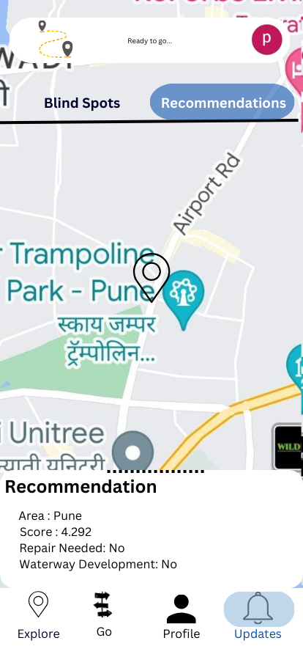
gallery

